Slide 1
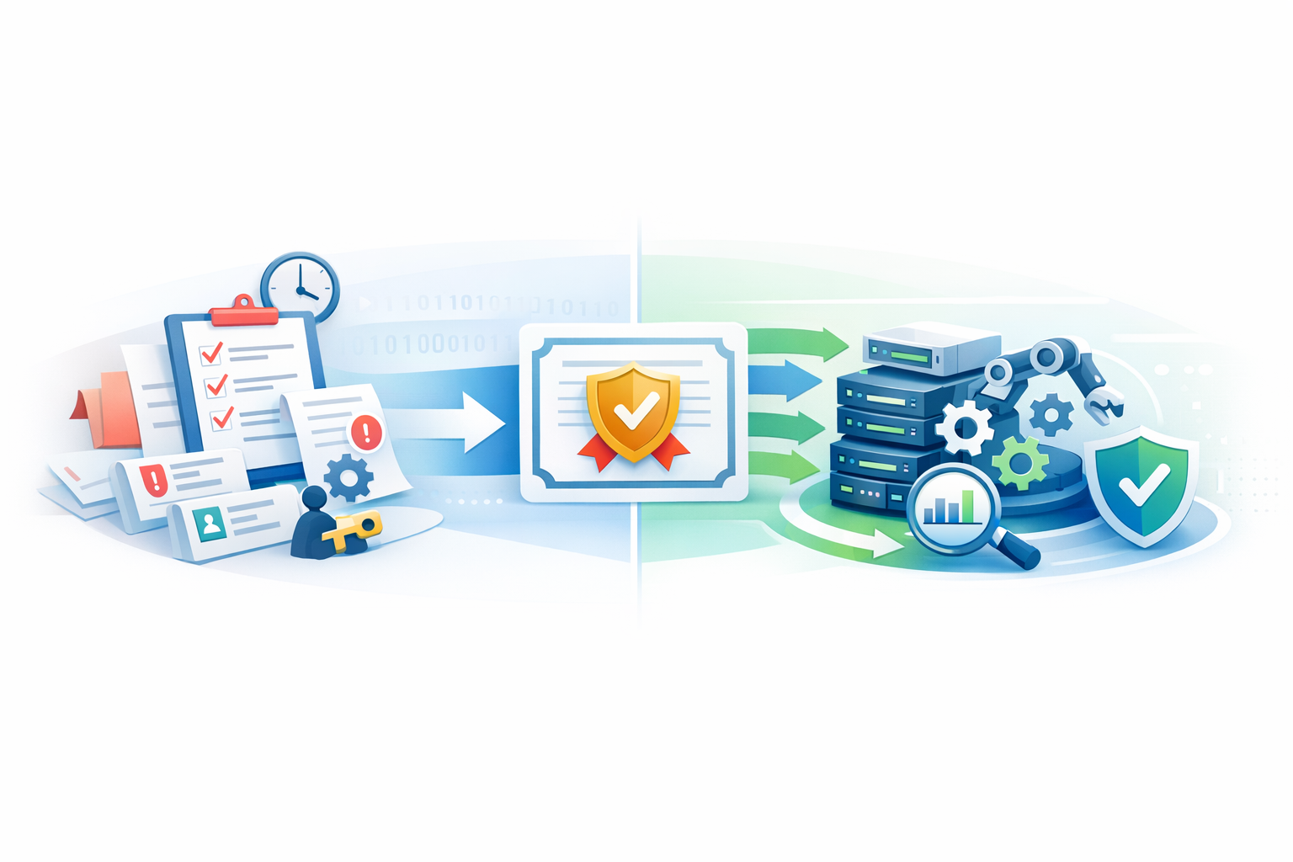
Certificate Renewal
Automation
From manual ticket-driven renewal to an end-to-end Ansible workflow for renewal, deployment, validation, reporting, and closure.
Venafi
ServiceNow
Ansible
What changes
Manual handoffs are replaced by a single orchestrated flow with built-in change handling and deployment validation.
Manual process on the left, automated operating model on the right

Slide 2
Before vs after process flow
Same objective, very different operating model
BEFORE
Human-triggered flow with manual requests, waits, and deployment steps
AFTER
Ansible-driven flow with renewal, deployment, validation, and closure in one chain
Expiry notification received
1
Ansible checks expiry in Venafi
1
2
Creates change in ServiceNow
Raise ServiceNow request to certificate management
2
Implements change in ServiceNow
3
Click RenewNow in Venafi
Automate
Renews certificate with vcertCli
3
4
Wait for renewal ticket completion
5
Downloads certificate and deploys to target hostnames
4
6
Deploys to web servers and validates
Raise release/change for non-prod or prod deployment
5
7
Sends deployment report
Click Install in Venafi to deploy to web servers
8
Closes ServiceNow change
6
6 manual touchpoints with multiple handoffs and waiting periods
8 automated actions in one orchestrated chain

Slide 3
Why automate certificate renewal?
Map today’s pain points directly to the target-state response
Pain in today’s process
Automation response
Expiry tracking depends on someone noticing and acting
Scheduled checks in Venafi can detect renewals continuously and consistently
Renewal requires ticket creation and team-to-team handoff
The workflow can create, implement, and close the ServiceNow change automatically
Deployment is disconnected from renewal, so timing is harder to control
Renewal, download, deployment, and validation can run in one ordered sequence
Manual waiting introduces delay and inconsistent execution
The same workflow can execute the same steps every time with fewer human pauses
Visibility comes late, after the work has already moved across teams
Reporting and change records provide a clear deployment trail at the end of each run
The manual flow adds avoidable coordination overhead, while the automated flow puts the full lifecycle into one governed, repeatable sequence.

Slide 4
Pros and cons of certificate automation
Benefits are strongest when paired with operational guardrails
Pros
Considerations
Lower manual effort
Faster turnaround
Upfront engineering
Removes repetitive ticketing, clicks, and coordination work.
Renewal and deployment can move in one execution path.
Needs initial workflow, integration, and credential setup.
Exception handling
More consistency
Better traceability
Failures, retries, and rollback paths must be designed.
The same workflow runs the same sequence each time.
Change creation, deployment, validation, and reporting stay linked.
Governance alignment
Automation still has to respect change and audit controls.
Higher scalability
Built-in validation
The pattern can be reused across more certificates and hostnames.
Deployment checks reduce the chance of silent post-renewal issues.
Operational monitoring
Jobs need logging, alerting, and clear ownership.
Mitigate with controls, monitoring, and rollback design

Slide 5
Recommended adoption path
Automate in phases so the operating model stays governed as it scales
Suggested rollout
1. Pilot
2. Validate
3. Guardrails
4. Expand
Start in non-prod with a small set of certificates and target hosts.
Prove renewal, deployment, validation, reporting, and change updates end to end.
Add monitoring, retry logic, rollback paths, and credential controls.
Roll out to production and broaden certificate coverage with confidence.
Operating principles
End state
Keep ServiceNow updates in the workflow for auditability.
A repeatable renewal pipeline that checks expiry, handles change activity, deploys safely, validates results, and reports completion with far less manual coordination.
Validate the deployed certificate before marking the run complete.
Assign ownership for monitoring, credential rotation, and exceptions.
Use manual intervention as the fallback path, not the default.

Slide 6
2026 delivery timeline
Non-prod in Q2, production in Q3, and broad completion by year-end
Quarter-by-quarter plan
Q1
Build & readiness
Q2
Deploy to non-prod
Q3
Deploy to prod
Q4
Complete by year-end
Finalize workflow design
Run non-prod renewals end to end
Start phased production rollout
Expand remaining coverage
Set up integrations and credentials
Test validation, reporting, and rollback
Onboard priority certificate groups
Stabilize dashboards and ownership
Prepare test certificates and target hosts
Sign off for production entry
Run hypercare and close early gaps
Finish outstanding gaps by Dec 2026
Target message: prove the automation safely in non-prod during Q2, take it into production in Q3, and use Q4 to finish coverage, stabilize operations, and complete the year-end rollout.

Slide 7
Readiness gates by phase
What must be true before moving from non-prod to prod and then to year-end completion
Q2 non-prod exit
Q3 prod entry
Q4 year-end completion
Renewal works end to end in non-prod
Priority production certificates are identified
Target certificate population is onboarded
Deployment validation passes on target hosts
Credentials and approvals are in place
Dashboards and reporting are steady-state
Rollback and failure paths are tested
Monitoring, alerting, and ownership are assigned
Open defects and gaps are closed
ServiceNow updates and reporting are correct
Runbooks exist for exception handling
Support model is handed to operations
Each phase gates the next: prove, approve, expand, and close

Slide 8
Executive summary and next steps
Use the plan to align owners, timeline, and the decisions needed to stay on track
What this deck is asking for
Approve the phased plan
Confirm ownership
Proceed with Q2 non-prod deployment, Q3 production rollout, and Q4 completion.
Lock owners for Ansible workflow, Venafi integration, ServiceNow flow, and production support.
Prioritize target scope
Track to year-end
Agree which certificate groups and hostnames are included in the first production waves.
Review progress by quarter and use readiness gates to manage risk before each move.
Bottom line
Certificate automation is worth adopting because it removes manual coordination from renewal and deployment. A phased rollout lets the team prove the workflow in Q2, scale it into production in Q3, and complete the broader transition by the end of 2026.

Slide 9
Detailed execution workflow
End-to-end flow including shared failure handling, incident creation, and IHS retry approval
passed / renewal required
Start
Precheck certificate
for renewal
Raise change
request
Implement change
request
Renew
certificate
Deploy certificate
keystore to server
Deploy certificate
to IHS server
Close change request
as successful
with success info
Send success
notification
End
precheck failed
renew failed
keystore deploy failed
IHS deploy failed
Fail End
Failure node
Set status unsuccessful
Add renew failure info
Failure node
Set status unsuccessful
Add keystore deployment
failure info
Failure node
Set status unsuccessful
Add IHS deployment
failure info
Close change request
as unsuccessful
Raise incident
Update change request
with incident details
Send failure
notification
End
Close change request
as unsuccessful
Raise incident
Update change request
with incident details
retry failure
Approval gate
Retry failed
IHS nodes
Send failure
notification to team
Close incident
Send success
notification to team
End
End

